Slide 1

SDM INSTITUTE OF TECHNOLOGY, UJIRE
DEPARTMENT OF ELECTRONICS & COMMUNICATION ENGINEERING
A Mini-Project synopsis Presentation on
Vedic Multiplier Using Carry Save Adder
Under the guidance of
Mr. Ramachandra
Asst. Professor
Department of ECE
Presented by,
Prathvi Kulkarni(4SU21EC062)
Praveen T U(4SU21EC064)
Rudra Gowda K S(4SU21EC077)
Umamaheshwari M Patil(4SU21EC095)

Slide 2
Introduction
1. Vedic mathematics, an ancient Indian method based on 16 Sutras, offers
efficient techniques for various mathematical operations.
2. The Urdhva Tiryagbhyam Sutra, means “Vertical and Crosswise”, simplifies
multiplication by breaking it into smaller steps, enabling faster digital
calculations.
3. This Sutra, combined with Carry-Save Adder for efficient binary summation,
significantly enhances the speed and accuracy of digital systems.
2

Slide 3
Literature Review
Paper Title | Summary | Learnings
[1] Modified binary vedic multiplication using Carry Save Adder | This project designs and analyzes Vedic Multiplier architectures using the Urdhva Tiryagbhyam sutra, showing improved delay efficiency. The proposed technique can be scaled for larger bit sizes and includes power analysis, making it suitable for applications requiring reduced delay. | It is proved from the synthesis result that the proposed Vedic multiplier using Carry Save Adder technique is much efficient in terms of delay and can be extended for a larger bit size.
[3] Comparative analysis of vedic multiplier using various adder architecture | The paper investigates the performance and efficiency of vedic multiplier utilizing different adder architectures. This study compares traditional adder designs like RCA,CSA with advanced kogge-stone adder when integrated into vedic multiplier implementation. | CSA is more suitable in applications where area plays an major role.
3

Slide 4
Problem Statement
Conventional multipliers and adders often suffer from large area requirements, time delays, and high-power consumption, making them inefficient for many applications. To overcome these issues, we propose designing a Vedic multiplier using Carry Save Adder (CSA).

Slide 5
Objective
1. To reduce the overall time delay in multiplication operations using
Vedic multiplier with Carry Save Adder (CSA).
2. To implement the design on FPGA Spartan 3E using Xilinx ISE.
5

Slide 6
Methodology
Design and implementation of 4x4 Vedic multiplier using Carry Save Adder(CSA)
b[3:0]
a[3:0]
4x4 VEDIC MULTIPLIER USING CARRY SAVE ADDER
y[7:0]
BLOCK DIAGRAM OF 4-BIT VEDIC MULTIPLIER
6

Slide 7
b[3:2]
a[3:2]
b[1:0]
a[3:2]
b[3:2]
a[1:0]
b[1:0]
a[1:0]
2x2 VEDIC MULTIPLIER
2x2 VEDIC MULTIPLIER
2x2 VEDIC MULTIPLIER
2x2 VEDIC MULTIPLIER`
[3:0]
[3:2]
[3:0]
[3:0]
4-BIT CSA
[1:0]
[3:2]
4-BIT CSA
[1:0]
[1:0]
y[7:0]
Result
y[ 7:4 ]
y[3:2]
y[1:0]
Internal Block diagram of the proposed work

Slide 8
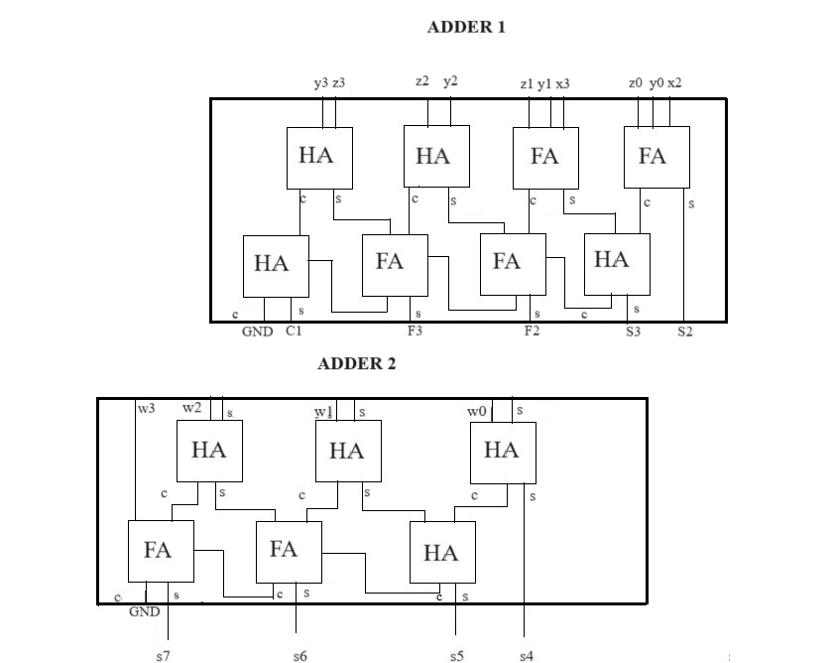
Internal Structure of Carry Save Adder

Slide 9
Example of 4-bit Vedic Multiplication
Step1: Vertical
11x11=1001
Step2:Cross-wise
(11x11)+(11x11)
=1001+1001
= 0000
+ 1 1
= 10010+10
= 10000
+ 1
= 10100
15:
15:
1 1 1 1
1 1 1 1
Step3:Vertical
11x11=1001
= 1001
+ 101
=1110
225:1110 0001
Final Sum:1110 0001
7

Slide 10
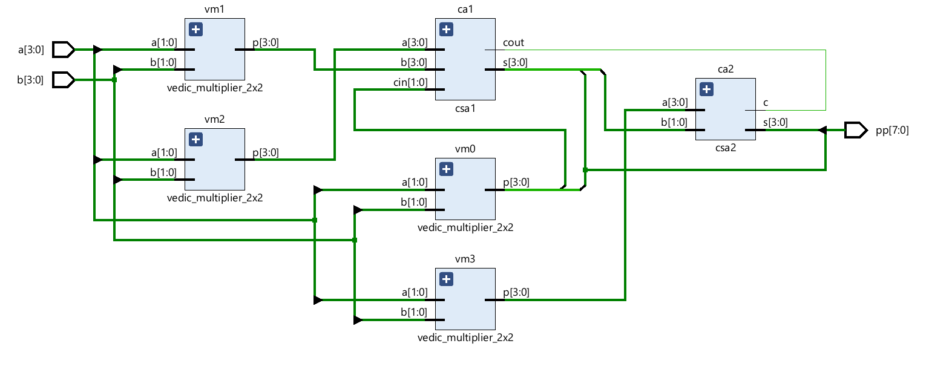
Outcomes of the proposed work
RTL schematic of proposed Vedic multiplier using CSA

Slide 11
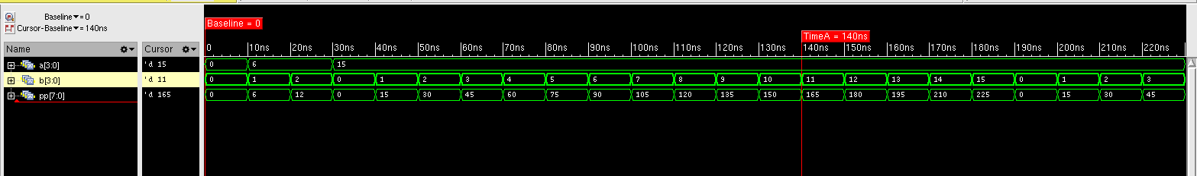
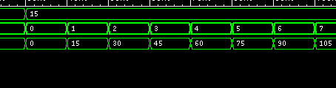
Waveforms

Slide 12
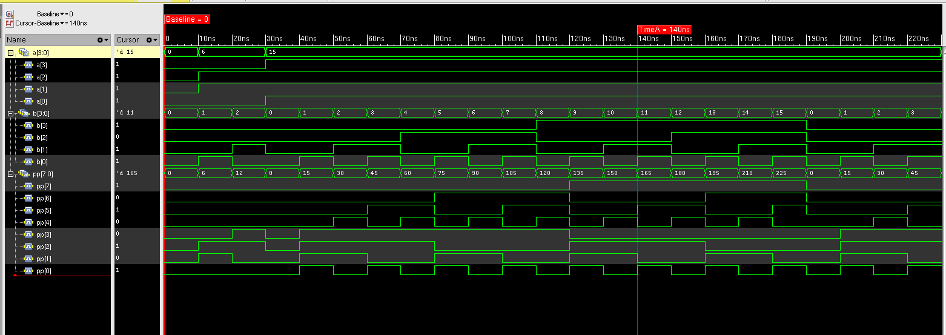

Slide 13
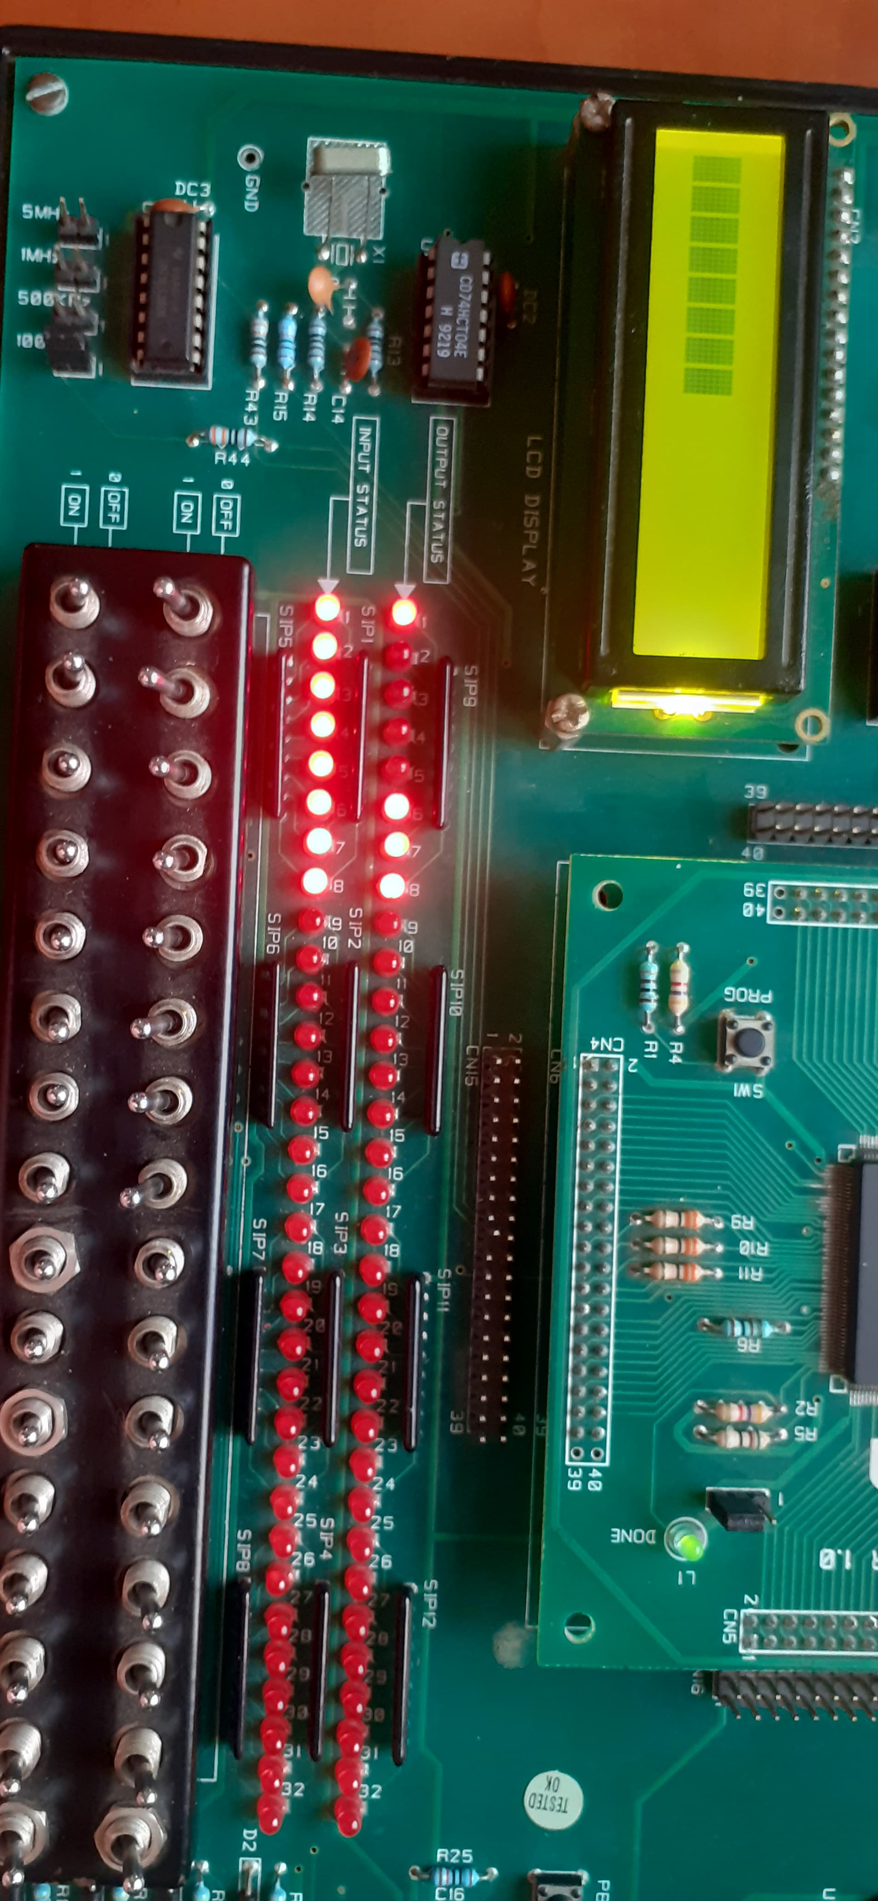
Implementation
Test case : a=15, b=15, y=225
b
a

Slide 14
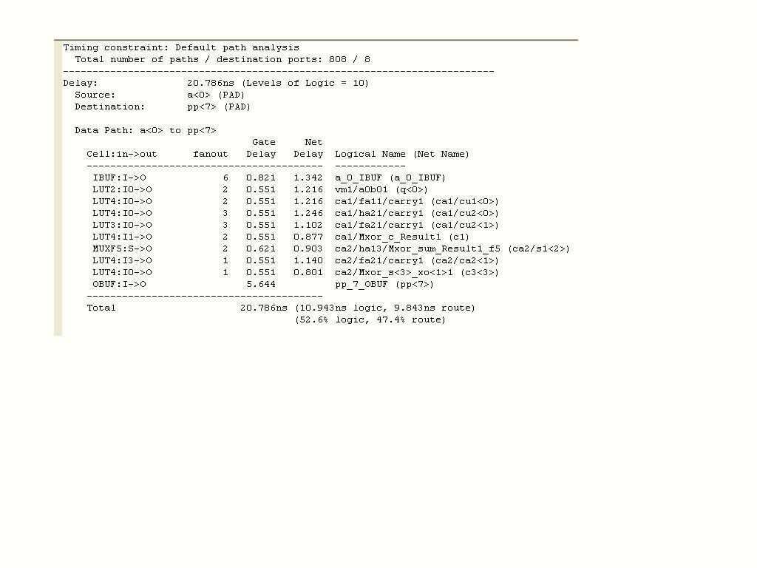

Timing Report of 4x4 Vedic multiplier using Carry Save Adder
The above figure shows the timing delay analysis of Vedic multiplier using Carry Save Adder.

Slide 15
Comparative analysis of Vedic multiplier with other adder and multiplier
DESIGN | TIME DELAY
VEDIC MULTIPLIER USING CARRY SAVE ADDER - 4X4 | 20.786 ns
VEDIC MULTIPLIER USING CARRY SELECT ADDER - 4X4 | 21.888 ns
BOOTH MULTIPLIER - 4X4 | 24.011 ns

Slide 16
The comparative analysis of the Vedic multiplier using Carry Select Adder exhibits slightly higher delay than Carry save Adder with time delay of 21.888 ns.
The comparative analysis using Booth multiplier exhibits higher delay than Vedic multiplier with time delay of 24.011 ns.
This indicates that the proposed Vedic Multiplier with Carry Save Adder is faster by approximately 3.225 ns compared to the Booth Multiplier.
The reduced time delay in our design suggests it is more efficient for applications requiring rapid multiplication operations.

Slide 17
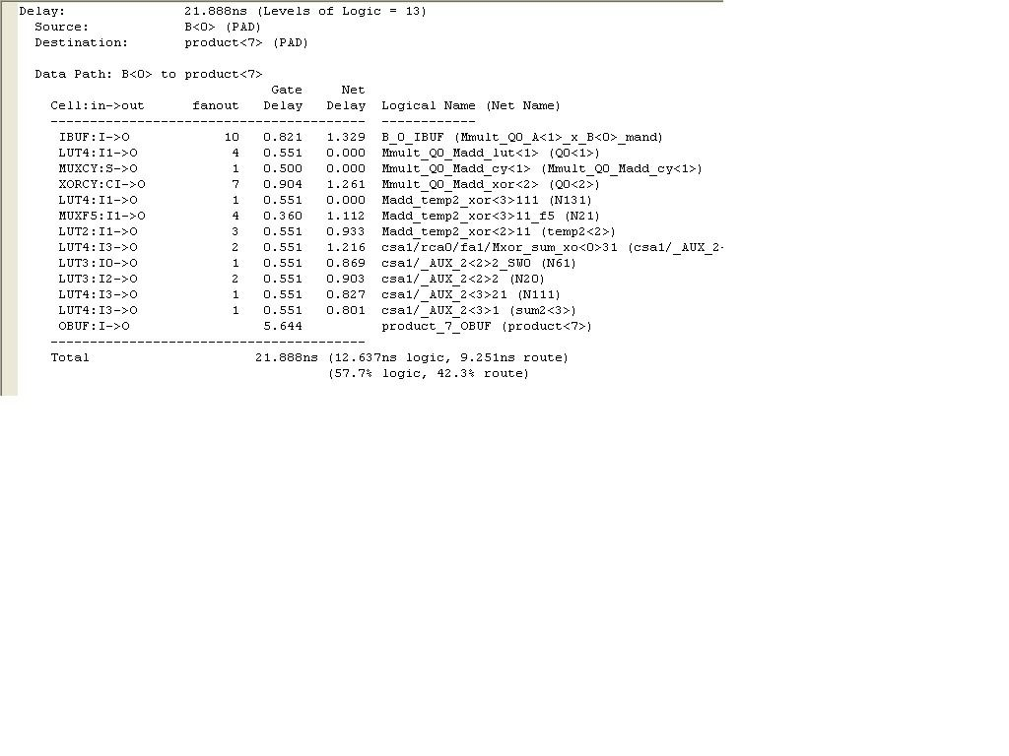
Timing Report of 4x4 Vedic multiplier using Carry Select Adder
The above figure shows the timing delay analysis of Vedic multiplier using Carry Select Adder.

Slide 18
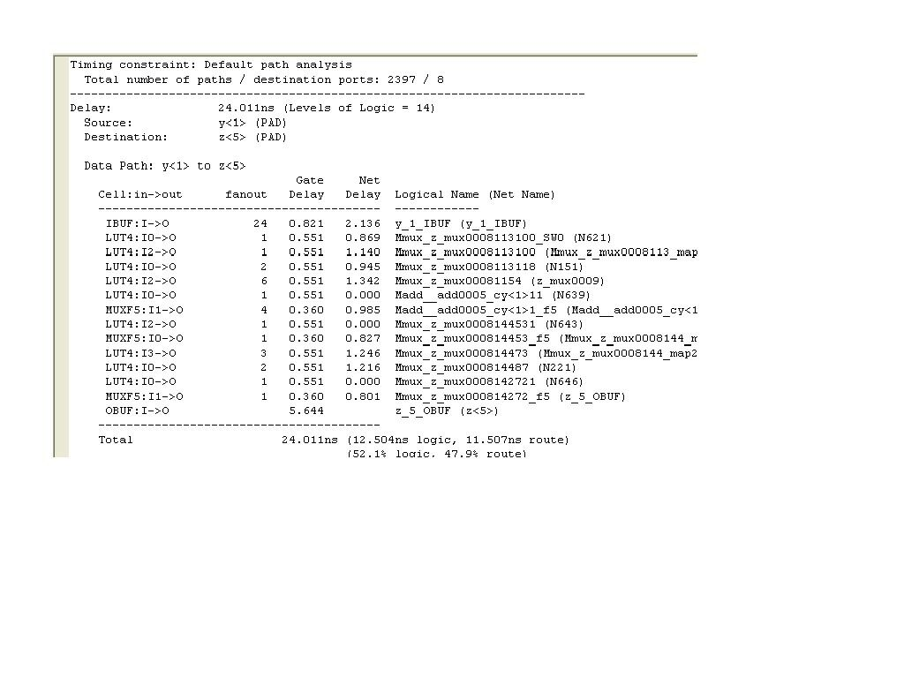

Timing Report of 4x4 Booth multiplier
The above figure shows the timing delay analysis of Vedic multiplier using Booth Multiplier.

Slide 19
Conclusion
The use of CSAs will minimize propagation delay in the addition process, leading to faster computation of the final product.
2. By efficiently summing partial products with reduced delay, the overall
performance and speed of the Vedic multiplier will be significantly improved.
3. Based on simulation results and Timing report the performance of the Vedic
Multiplier is more efficient than other Multipliers.

Slide 20
Thank you
9

